Slide 1



SMART INDIA HACKATHON 2026
TECH TIDE </>
  Problem Statement ID – SIH26040
  Problem Statement Title- Smart Water Purification and Quality Monitoring System for Rural and Mining-Affected Areas.
  Theme- Clean & Green Technology
  PS Category- Hardware
  Team ID-
  Team Name (Registered on portal)- Tech Tide </>

Slide 2

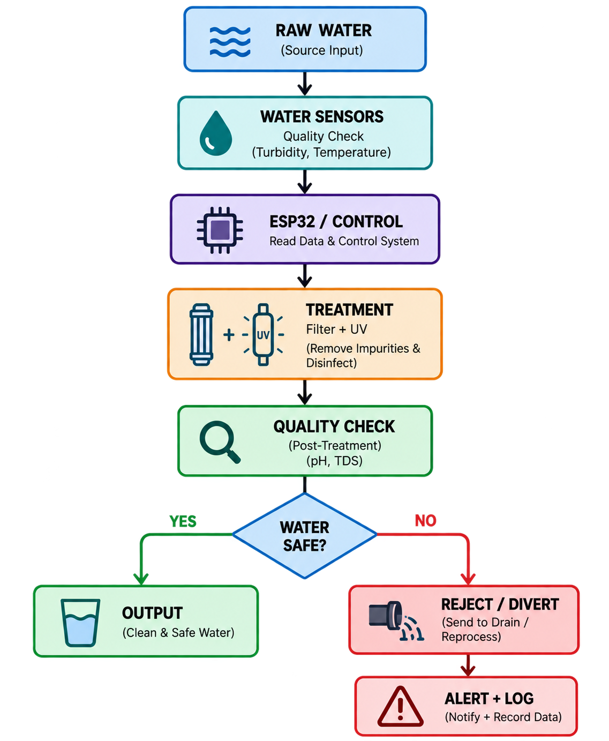
IoT-Based Real-Time Water Quality Detection, Treatment & Alert System
The Problem
Idea / Solution
Water quality varies significantly: Conventional purification systems may not detect changing water-quality conditions in real time.
  Invisible contamination risk: Users may receive water without knowing whether key quality parameters are within acceptable limits.
  No closed-loop response: Existing systems generally separate quality monitoring, treatment and user alerts, limiting timely intervention.
Real-Time Monitoring: pH, TDS, turbidity & temperature
Jharkhand-Specific Module: Local contaminants → targeted treatment
Smart Control: ESP32 + pump + valves
Multi-Stage Treatment: Filtration + UV
Quality Re-check: Post-treatment verification
Reject & Alert: Unsafe water → divert + alert
Innovation / Uniqueness
Proposed Solution
Closed-Loop Purification
Sense → Treat → Re-check → Deliver/Reject
Real-Time Automation
Treatment & water flow based on sensor readings.
Safety-Based Rejection
Unsafe water → Auto-divert + Alert
Integrated Monitoring
Sensors + Treatment + Alerts + Data Logging
(in one system).
Our system integrates real-time water quality sensing, intelligent treatment control and user alerts into a single closed-loop platform.
Sensors continuously monitor water quality → ESP32/controller analyses the readings → filtration/disinfection stages are activated as required → water is re-tested before being classified as acceptable.

Slide 3

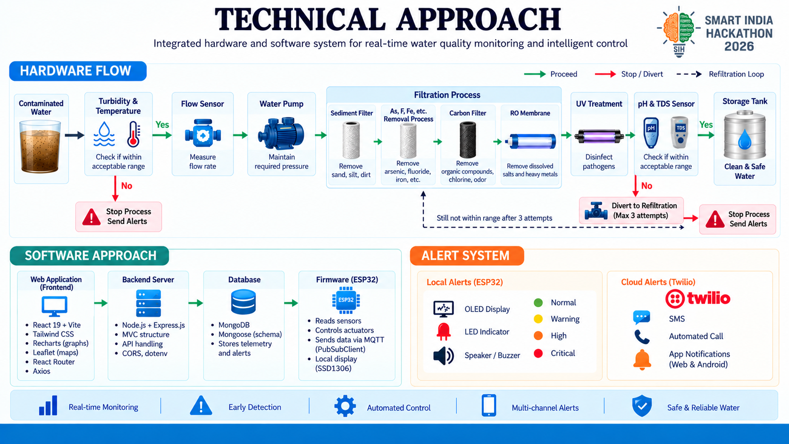

Slide 4
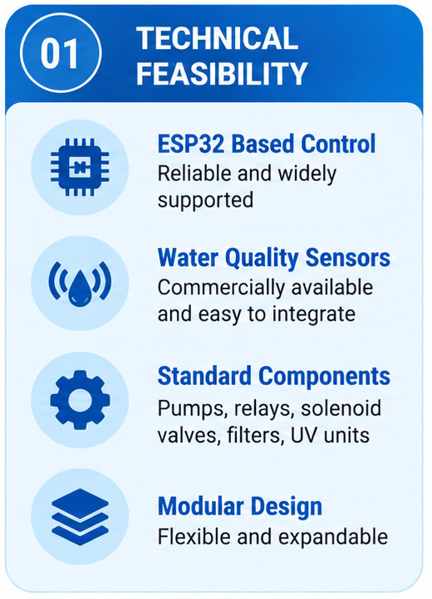
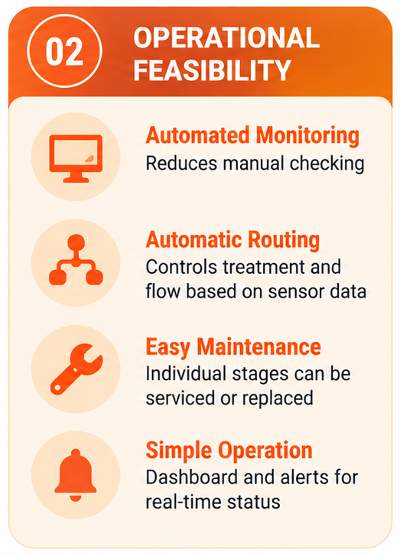
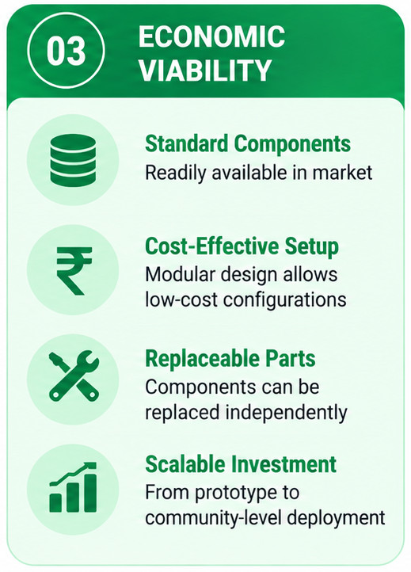
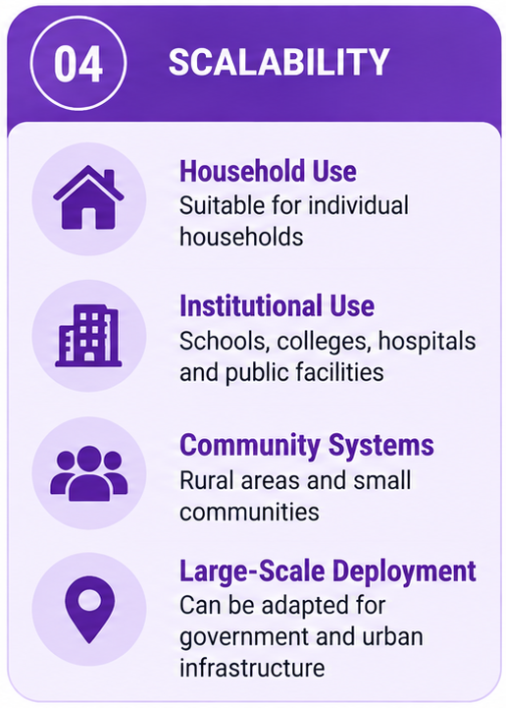

FEASIBILITY AND VIABILITY
Notes:
4

Slide 5
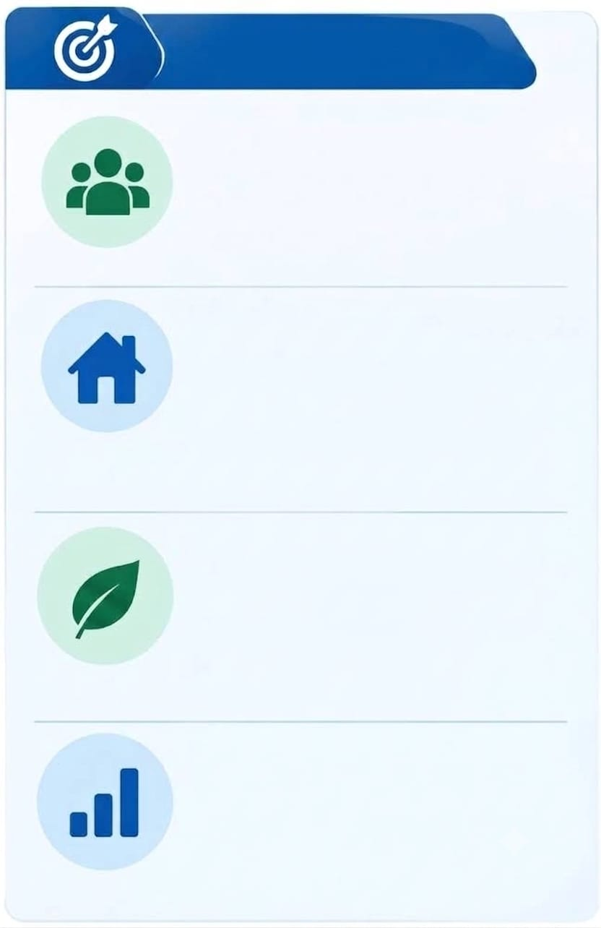
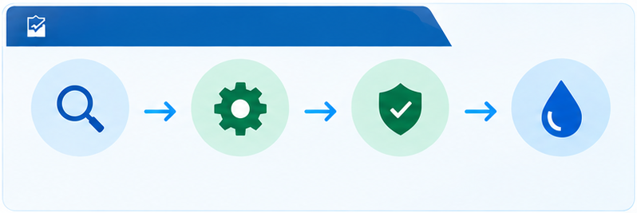
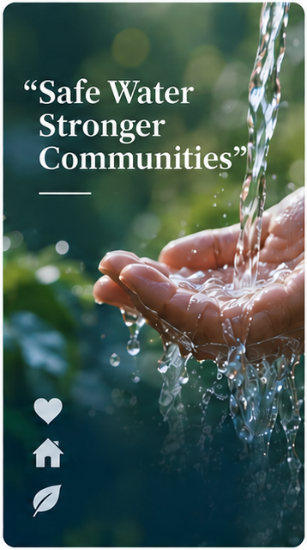
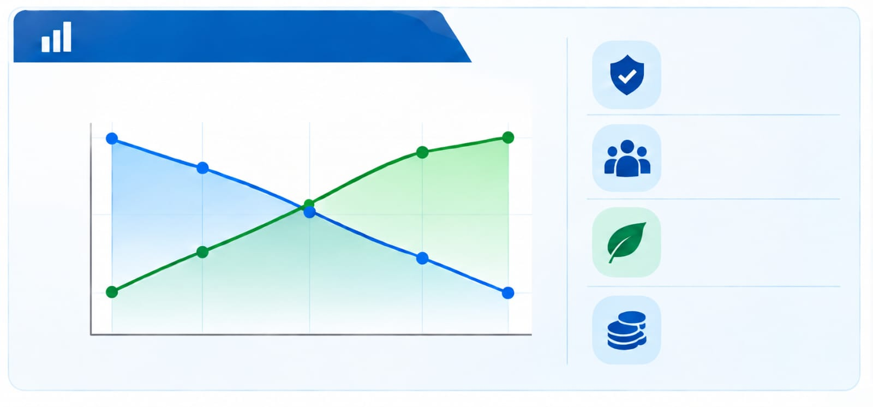
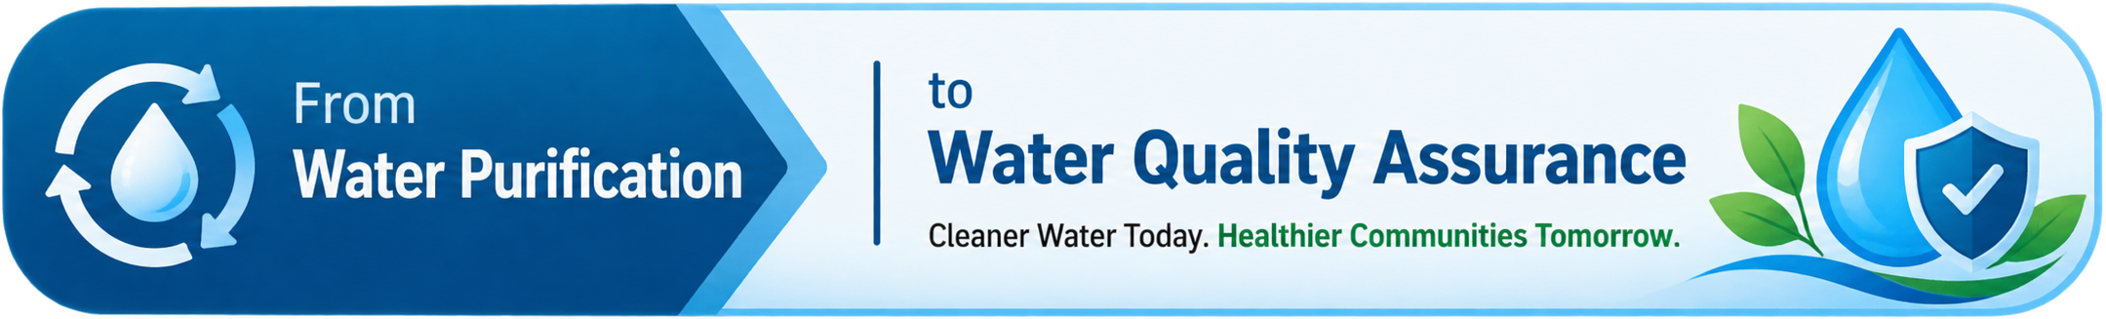
IMPACT AND BENEFITS
KEY IMPACT
FROM MONITORING TO SAFER TOMMOROW
PUBLIC HEALTH
Reduces risk of delivering unsafe water
Additional quality verification layer
MONITOR
TREAT
VERIFY
DELIVER SAFE WATER
Check water quality
Automated purification
Re-check quality
Or divert & alert
RURAL & LOCAL COMMUNITIES
Supports areas where manual testing is difficult
Enables localized monitoring and alerts
GREATER IMPACT OVER TIME
Safer Communities
Risk of unsafe water delivery
Community trust & safety
🔵
🟢
High
Higher
Public Trust
RESOURCE EFFICIENCY
Treatment driven by sensor readings
Unsafe water → Auto-reject & divert
Medium
Lower
Environmental Risk
Low
Healthier Lives
DATA-DRIVEN MANAGEMENT
Better Resource
Utilization
Before
After
Resilient Communities
Historical data → Water-quality trends
Real-time alerts → Faster response
Sustainable Future
Notes:
5

Slide 6
RESEARCH AND REFERENCES
Government & Standards
Jharkhand Government – Drinking Water & Sanitation
Jal Jeevan Mission – Water Quality Management
Central Ground Water Board – Groundwater Quality
Jharkhand Economic Survey 2025–26
Bureau of Indian Standards – IS 10500
Technical & Scientific Sources
WHO – Guidelines for Drinking-water Quality
WHO – Arsenic in Drinking Water
WHO – Fluoride in Drinking Water
WHO – Nitrate/Nitrite in Drinking Water
WHO – Uranium in Drinking Water
WHO – Chemical Hazards in Drinking Water
CDC – Home Water Treatment Systems
US EPA – Drinking Water Treatment Technologies
CDC/NIOSH – UV-LED Water Disinfection Research
Notes:
6

